Slide 1
Methane Digesters
Miki Furman

Slide 2
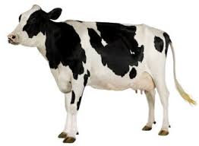
Anaerobic bacteria
Anaerobic bacteria are bacteria that do not require oxygen, some of which only survive in conditions lacking in oxygen.
Methanogens, which play the important role of producing methane in anaerobic digestion, are anaerobic bacteria.
These methanogens may be found in the waste of certain animals.
Image: www.activityvillage.co.uk

Slide 3
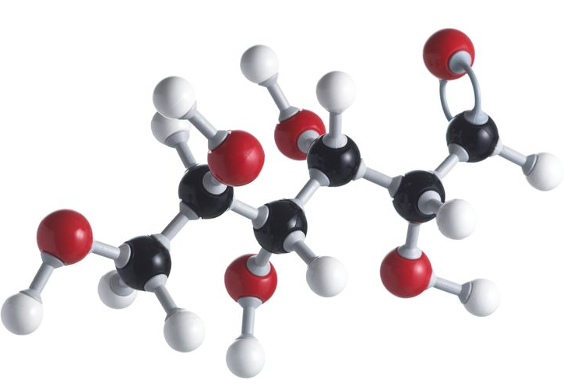
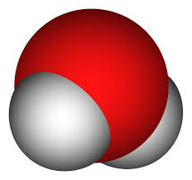


Chemical process
During the process of anaerobic digestion, bacteria eat the waste and burp out carbon dioxide and methane. This process would look something like:
Glucose (C₆H₁₂O₆) 3(CO₂)+3(H₂O)
Bacteria
Many other biological and chemical processes will occur during digestion to turn long chains of proteins, fats and carbohydrates into only a few simple molecules

Slide 4
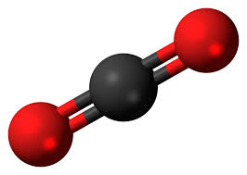
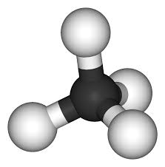
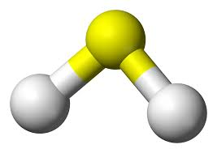
What is anaerobic digestion?
Organic wastes may be divided into three categories: carbohydrates, proteins and fats. Each of these are broken down throughout the anaerobic digestion process into smaller and smaller molecules, until significant amounts of only carbon dioxide and methane remain, with trace amounts of hydrogen sulfide in the gas that arises.

Slide 5
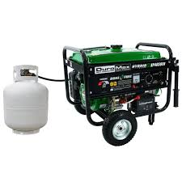
Energy
Burning the resultant gas is the simplest way to get energy from it. Unfortunately, carbon dioxide is not flammable at all, and just dilutes the methane. To get a purer gas (or automobile grade gas), large scale operations may use a carbon trap and scrub out the hydrogen sulfide, but smaller, household sized digesters rarely have to worry about the carbon dioxide or hydrogen sulfide, because the majority of the gas is still methane.

Slide 6
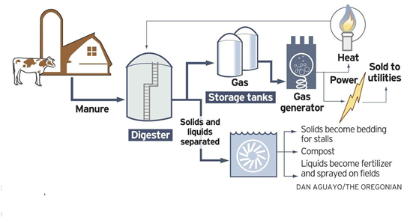
Large scale digesters
Dairy farms are some of the best places to implement methane digesters, because they have large amounts of organic waste, and are typically very energy consuming operations. A model for a dairy farm may look something like:

Slide 7

Cost
Using this model, farming operations can make money from not only selling their meat products, but also from selling their excess electricity back to utilities. Something that stops many farms from doing this, however, is the high initial cost. It can take five years to build a large scale digester, and even longer for the bacteria to reach a point where they produce the best.

Slide 8
End

